Slide 1
Welcome – benhams class 2023 - 2024
Mrs Kirsty Caddick
Mrs Selena Cameron

Slide 2
Benhams Class staff
Monday, Tuesday & Wednesday: Mrs Caddick
Thursday and Friday: Mrs Cameron
Our class LSA is Mrs Arturi: Tuesday-Thursday mornings
Mrs Arturi will be covering PPA within the class this year.

Slide 3
ROUTINES
- Independence – encourage your child to be responsible for their belongings and organise themselves.
- Please be on time – 8.35am (Learning begins at 8.35am/ Register is taken at 8.50am)
- Concerns – don’t wait, please catch us on the door at the end of the day OR contact us via email/school office/letter or note
- Pencil cases – must be small enough to fit in trays.
- Water bottles, reading books and Reading Journals need to be brought in and taken home every day.
- PE kit to be worn to school on WEDNESDAY and FRIDAY until October half term, then it will be WEDNESDAY and THURSDAY.
Homework (CGP books) to be handed in & marked in school every Monday. Spellings are also checked throughout the week.
Times Tables tests (Superheroes) are tested on a Monday.

Slide 4
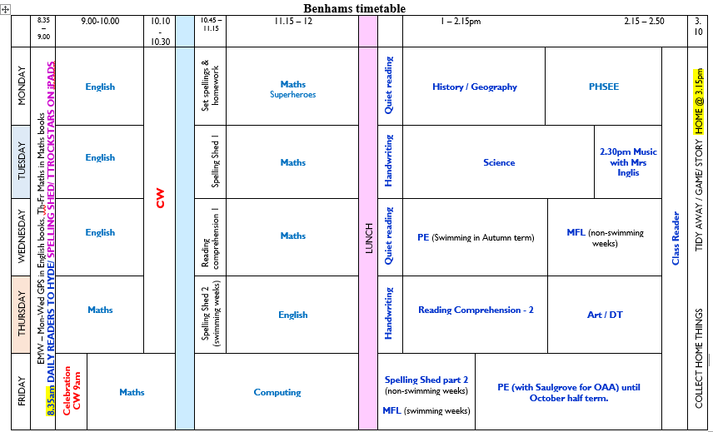
Timetable

Slide 5
curriculum
BENHAMS | Autumn term
Year A | Mayans/Extreme Earth
SCIENCE | Animals and habitats / Properties and changes of materials
COMPUTING | Online safety / Concept maps / Spreadsheets
HISTORY | Mayans
GEOGRAPHY | Extreme Earth
ART | Clay masks
DT | Frame structures – Mayan truffle boxes
PE | OAA (Orienteering), Swimming and Tag Rugby
RE | Humanism – a good life / Islam – community
MUSIC | Recorders / Singing games
MFL | Getting to know you / All about ourselves
PSHEE | Get Heartsmart / Don’t forget to let love in

Slide 6
assessment
- Reading - Benchmarking (unless a free reader).
- OTrack – termly assessment. A breakdown of assessments will be shared with parents at Parent Consultation Meetings.
- SATs – week beginning Monday 13th May. An information meeting will take place nearer the time for YEAR 6 parents.
- Increase in amount of formal tests throughout the year in Y6, in preparation for SATs.

Slide 7
homework
- Reading – daily. Please record each read in your child’s orange journal. (All passwords to online homework activities [Spelling shed/TTrockstars/Mymaths] are glued onto the inside covers of the orange books.)
- Spellings – weekly tasks. New lists are given out each Monday, on TEAMS.
- Times tables – Superhero challenge on a Monday
- My Maths – task online weekly.
- CGP Published Workbooks. (Set on a Monday on TEAMS and due the following Monday – answers are in the back for your child to check their answers. We will be marking them in class on Monday mornings)

Slide 8
RESPONSIBILITIES and perks
All Y5 and Y6 children will have a responsibility within school. They have all written an application for the role/s.
- JRSO
- Librarian
- House Captain
- School Councillor
- Collective Worship Monitors
- Green Rangers / Gardeners
- Register monitor
- Guinea Pig carer
- Hall monitor
- Gate monitor
- Reading buddies with Hyde class
- Good News certificates and Lego bricks – children are awarded a Good News certificate for excellent work and the class can earn Lego bricks for good behaviour, teamwork etc.

Slide 9
Ways to help
- Name everything!
- Read the weekly newsletter
- Try to make doctor/dentist/optician appointments after school or in the holidays
- Encourage your child to do their homework
- Talk to us at the first sign of any problem

Slide 10
Any questions?

